Slide 1
Team 9
HW2

Slide 2




Team introduction
Name：Yi-Cheng Shih
Contribution：
IPO、flow chart
Name：Poyang Lin
Contribution：
Basic information、 translation
Name：Yuan-Hsien Lin
Contribution：Video、
edit、combination
Name：Wei-Chih Chang
Contribution：Idea 、Expectation

Slide 3
Idea : Classification of letters & packages
Currently, Chunghwa Post Co. classifies letters or packages by seeing the ZIP code on them, and they are all done by human. So we came up with an idea of changing the ZIP code into something that can be scanned. Just by scanning the code and go through the programming we designed, the classification then can be done easily.

Slide 4

video

Slide 5

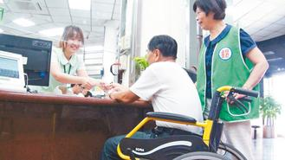
Basic information
Base on the information given, the Monthly salary of the respective department per person will be 30,075
Base on the admission of the new staff members in 2019, the total number of the staff incharge will be 225 members
From the information given, We come up with the idea in order to make the whole working process more efficient.

Slide 6

Expectation
By calculating the statics we got, we expect to save 225 staffs for the Chunghwa Post. It causes total 225(people) x 30075($/person) a month, and that equals to almost 6.8 million. ​

Slide 7
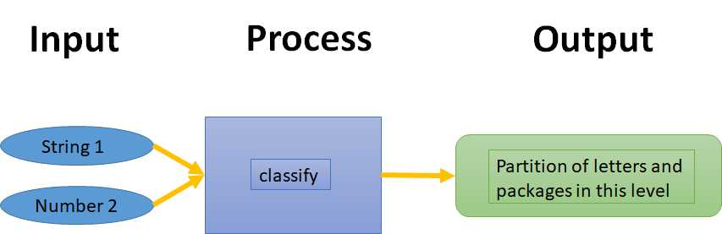
I-P-O Cycle
String 1 ：ZIP code( 5 integers )
Number 2 ：the least digit we hope to classify(1~5)

Slide 8
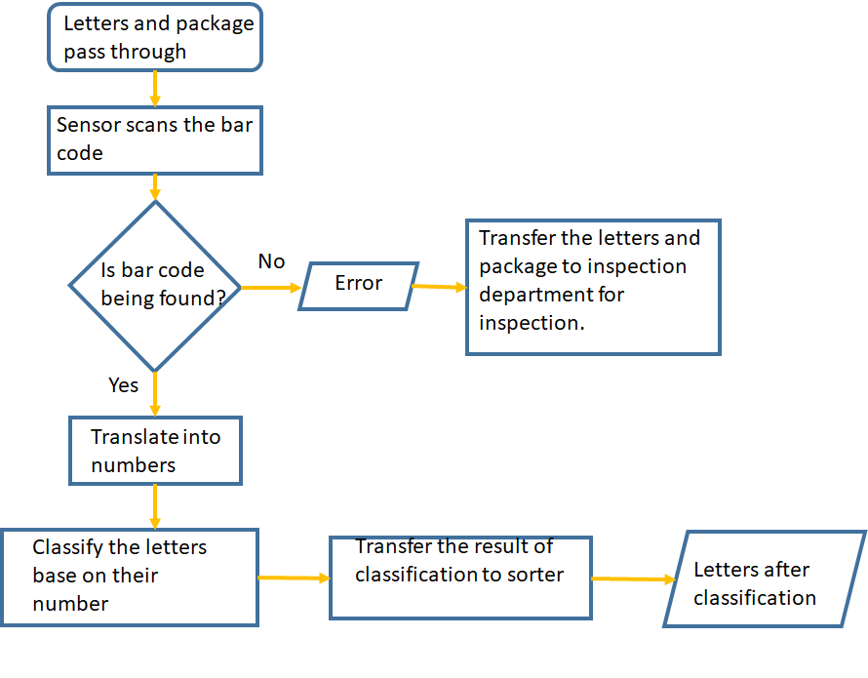
Flow chart

Slide 9

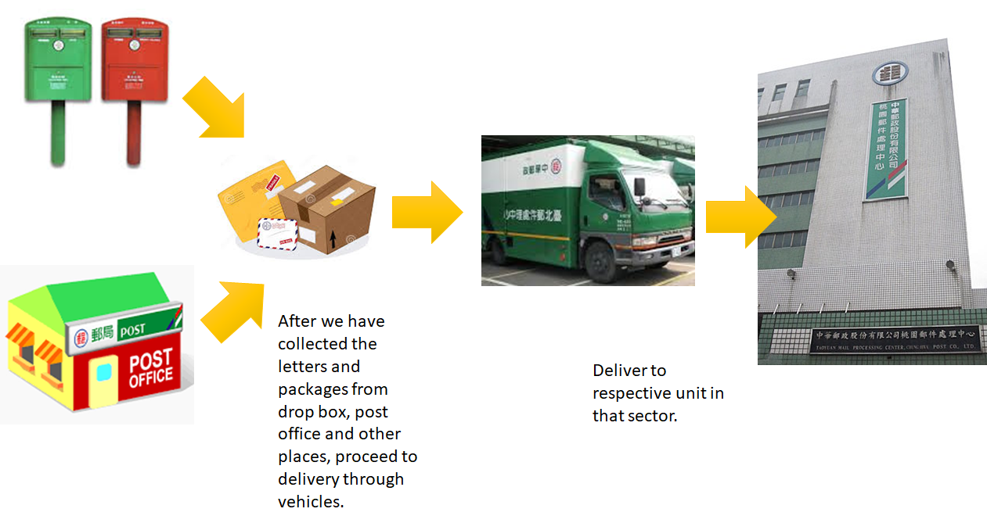


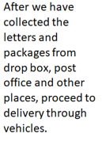
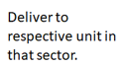

Delivery route

Slide 10
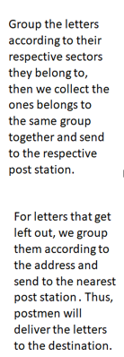
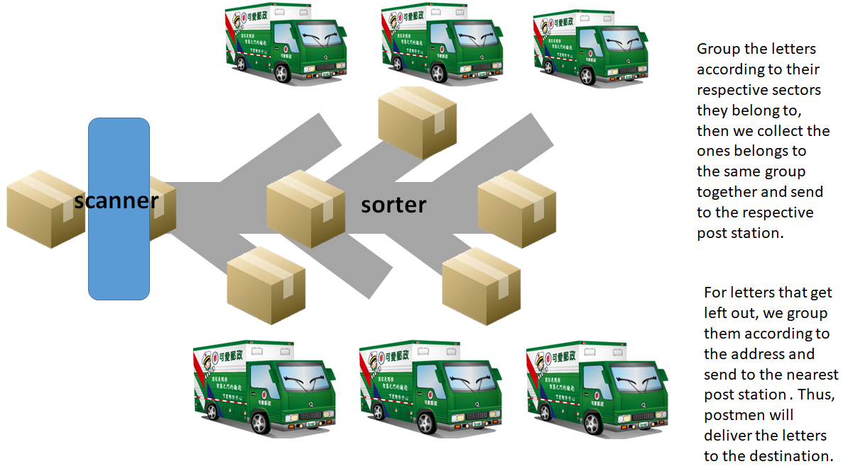
Delivery route

Slide 11
sources
http://cloud.easylearn.com.tw/exam_web_post-2.html
https://taiwanpowerexam.pixnet.net/blog/post/36614593-%E4%B8%AD%E8%8F%AF%E9%83%B5%E6%94%BF%E6%8B%9B%E8%80%83-%E9%83%B5%E5%B1%80%E6%8B%9B%E8%80%83-%E9%8C%84%E5%8F%96%E7%8E%87-%E5%A0%B1%E5%90%8D%E4%BA%BA%E6%95%B8-%E9%83%B5
https://www.youtube.com/watch?v=je_STVru26Y

